Slide 1
Leprosy
Dr. Indira Kahawita
Consultant Dermatologist,
BH Homagama

Slide 2
OVERVIEW
Epidemiology of leprosy in Sri Lanka
Clinical presentations
Diagnosis and management
New trends

Slide 3
What is leprosy?
Chronic infection of the skin and nerves
Due to the intra cellular mycobacterium, Mycobacterium leprae
The most probable route of infection is by respiratory droplets
Not usually spread by close contact through intact skin
Long incubation period, sometimes up to 5-10 years
Associated with a high degree of stigma, due to disability
Most disability is due to neuropathy
Neuropathy can be prevented and reversible if detected early
Need to diagnose patients and treat them early to prevent permanent sequelae

Slide 4
Why is leprosy important?
Sri Lanka achieved WHO target of elimination of leprosy as a public health problem in 1997
This means a national point prevalence of less than 1 case per 10000 population
With declaration of elimination many health workers and the general public are left with the idea that there are no cases of leprosy in Sri Lanka
Hence many doctors do not include leprosy in the differential diagnosis

Slide 5
What is the epidemiology of leprosy in Sri Lanka?
There are approximately 2000 new cases reported every year
This number has remained static over past 15 years
About 10% are children below 15 years of age
About 7% have visible disability at presentation
Only about 40% are started on treatment within 6 months of onset of symptoms
Sri Lanka is among the top 17 countries reporting over 1000 new cases every year

Slide 6
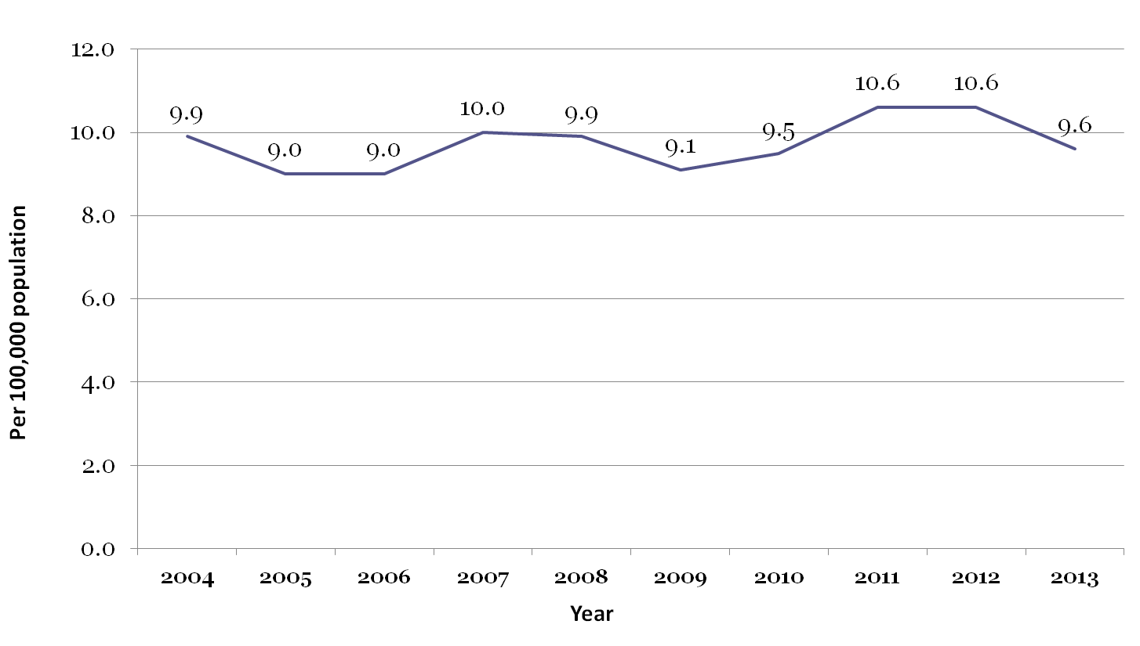
New Case Detection Rates of leprosy 2003 - 2013
9/12/2018
6

Slide 7
Percentages of child cases among all leprosy patients in Sri Lanka 2003-2013

Slide 8
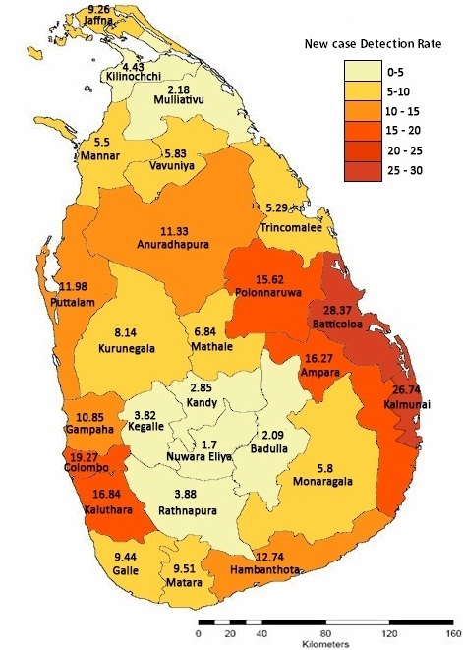
New case detection rates district wise 2013

Slide 9
Situation of leprosy in Sri Lanka 2016
Total number of new cases: 1751
MB cases: 933 (53.28%)
Child cases: 155 (8.85%)
Grade II disability: 131 (7.48%)
Grade I disability: 304 (17.36%)
Source: Anti Leprosy Campaign

Slide 10
What is the role of doctors in controlling leprosy?
Remember that leprosy is still a problem in Sri Lanka
Think of leprosy in your differential diagnosis of skin lesions and neurological manifestations
Refer to the nearest skin clinic. Almost all cases of leprosy are managed by Dermatologists.
A referral querying leprosy will be given priority at all skin clinics

Slide 11
Common presentations of leprosy

Slide 12
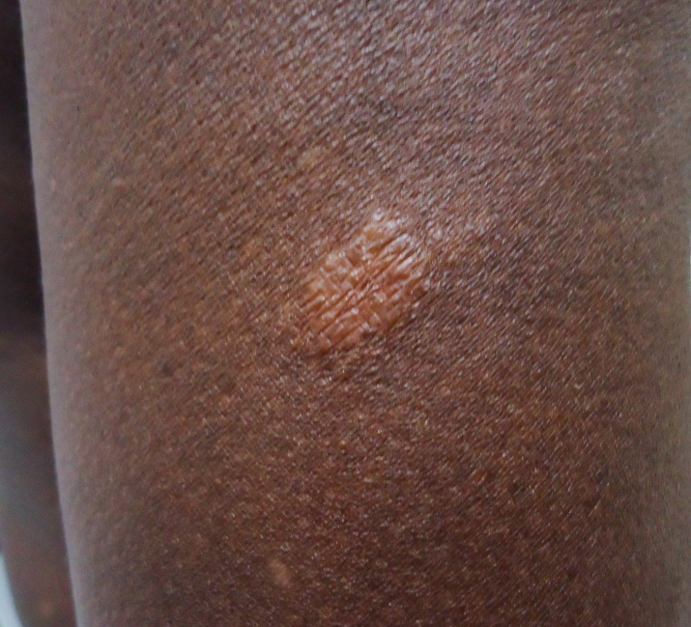
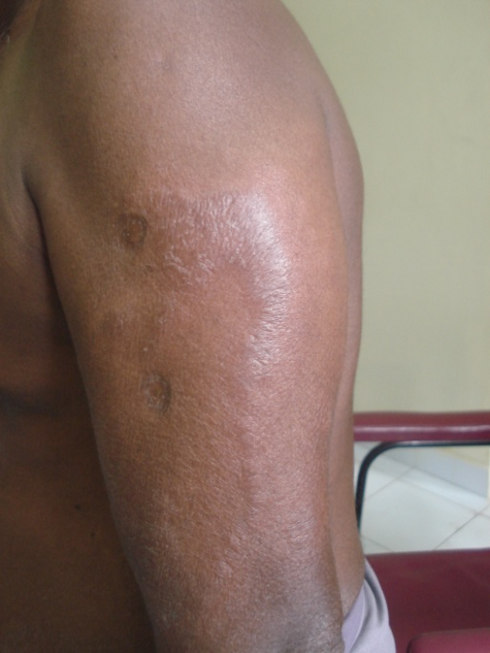
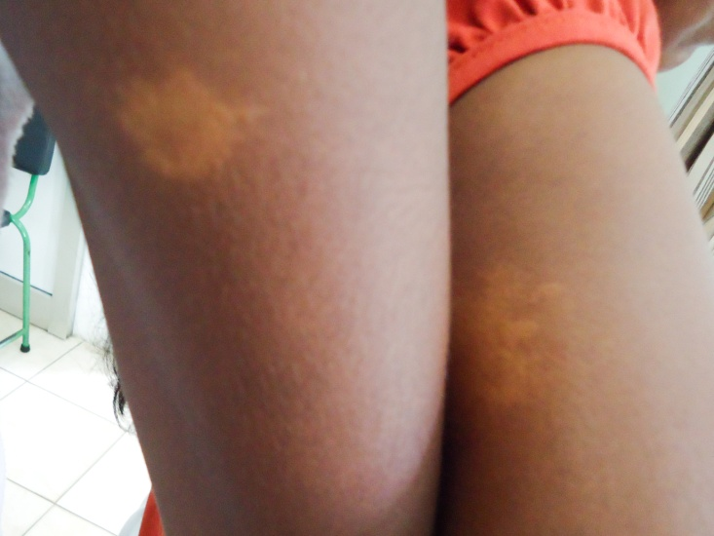
Hypo-pigmented anaesthetic patch
Usually single/ few patches
Hypo-pigmented/ copper coloured
Dry, less hair in the patch
Reduced/ loss of sensation in lesion
May have a thickened feeder nerve
Thickened nerve trunk in proximity to lesion

Slide 13
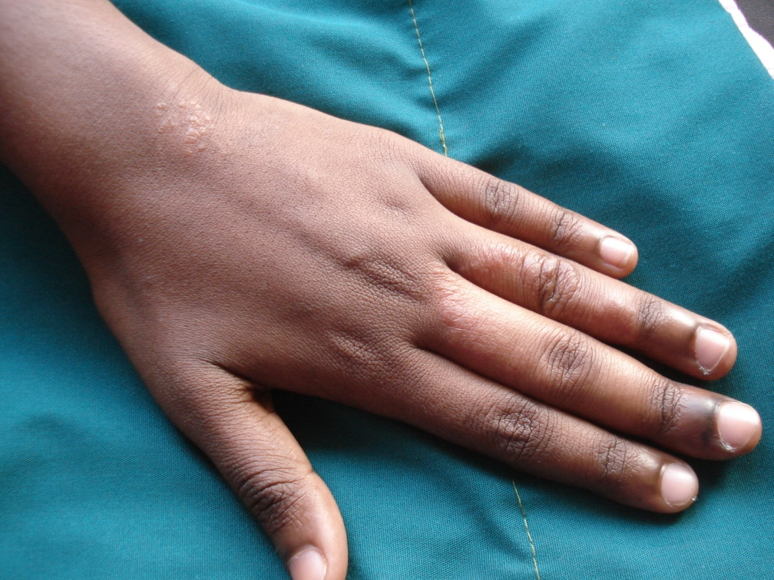
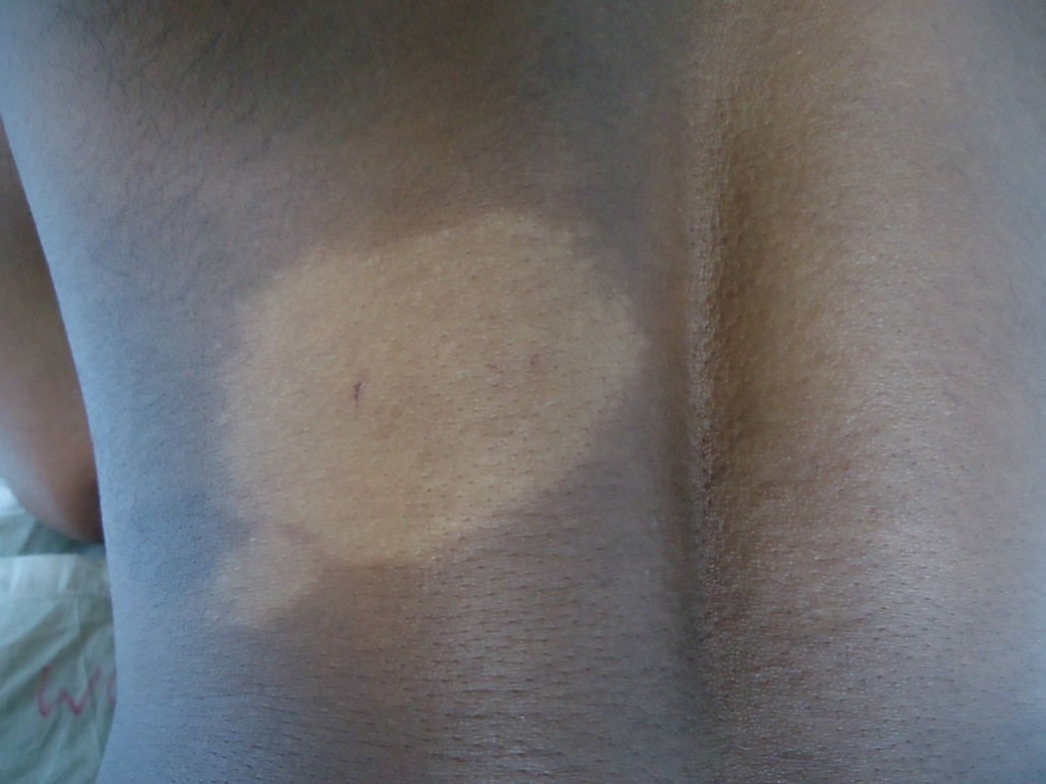
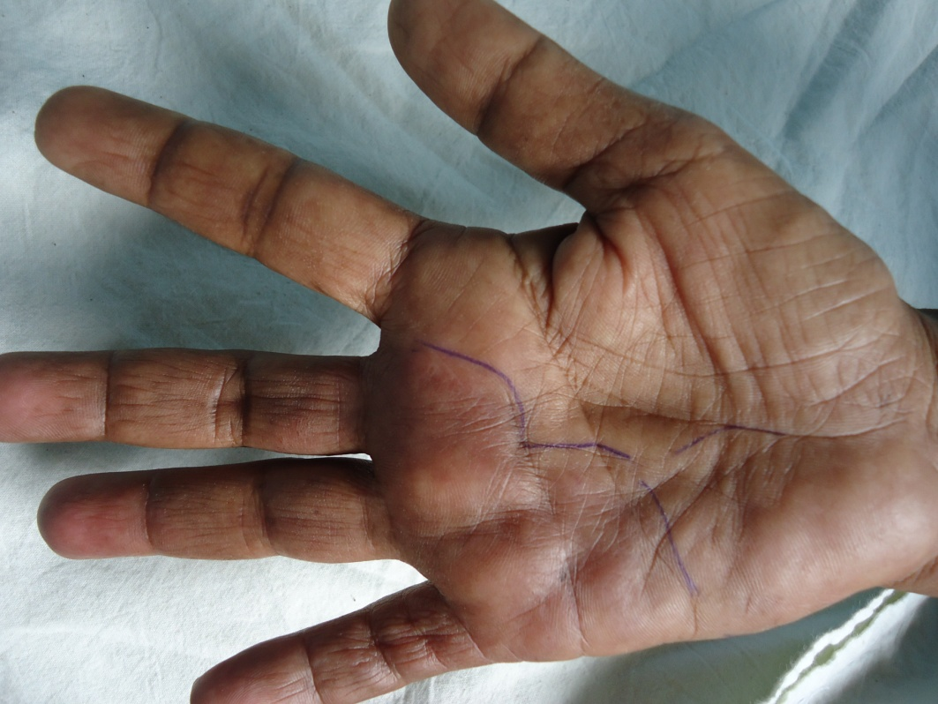
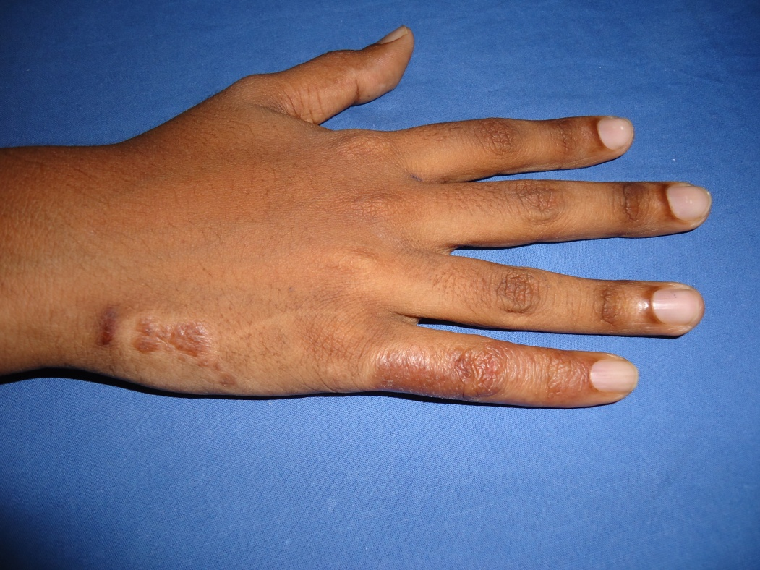

Slide 14
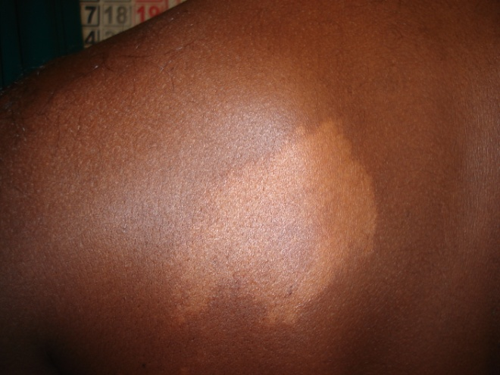
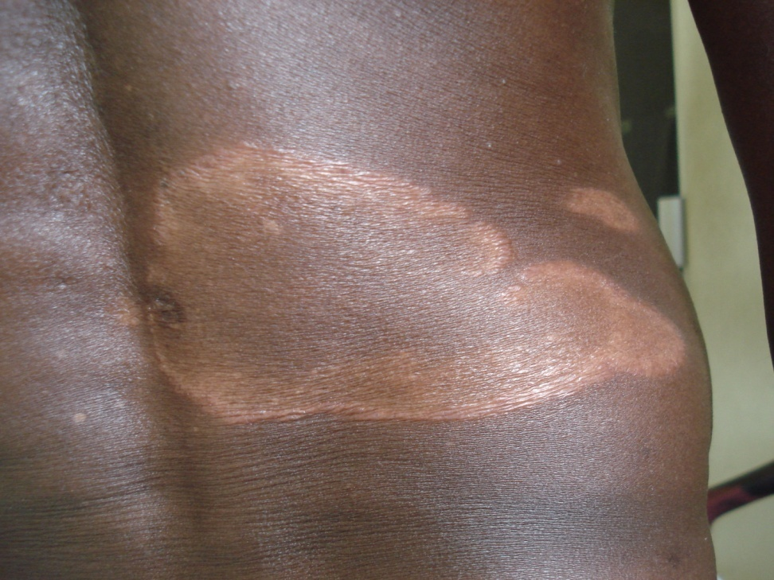
Lesions may be copper coloured in dark skin

Slide 15
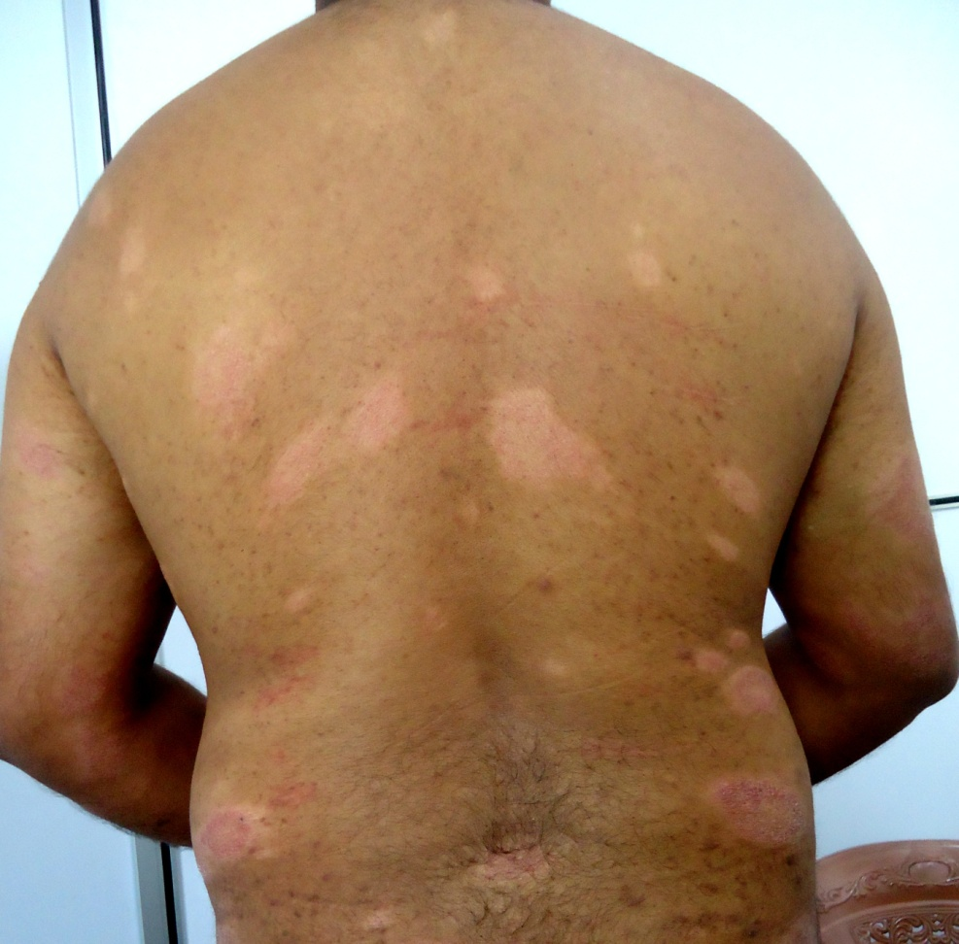
Multiple hypo-pigmented patches
Usually in the trunk
May be symmetrical
May not have sensory impairment
Associated peripheral neuropathy

Slide 16
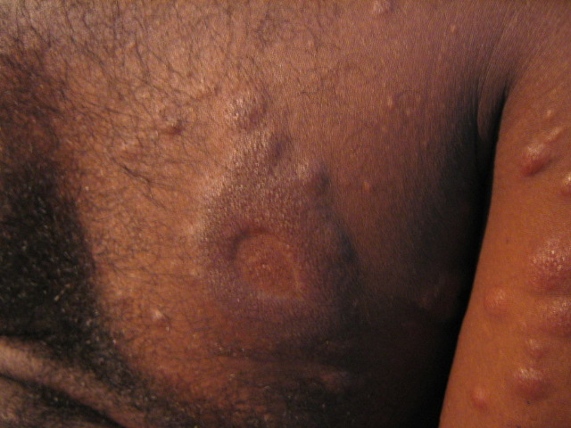
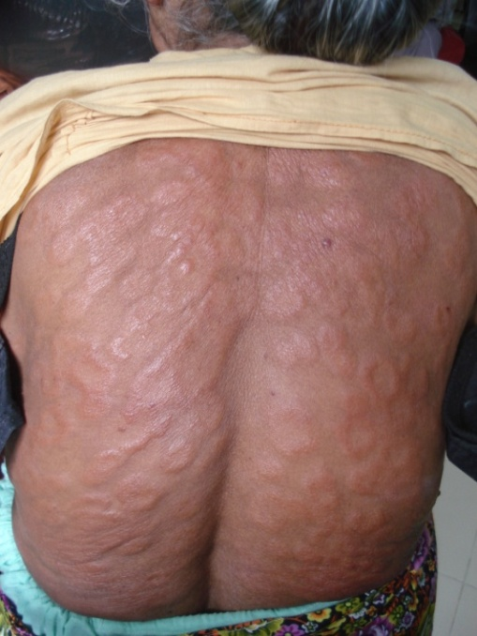
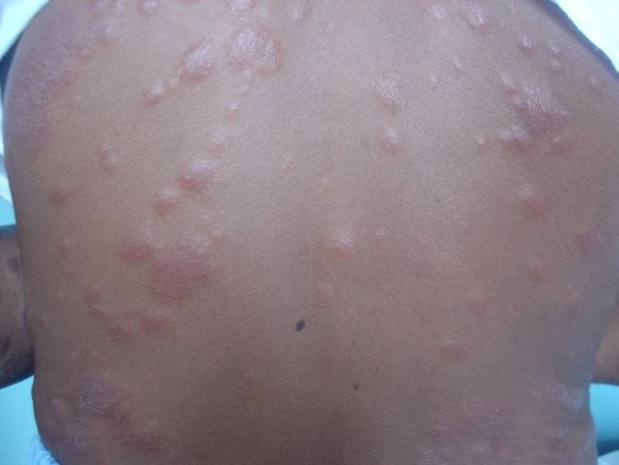
Plaques and nodules
Multiple lesions
Erythematous/ skin coloured
Symmetrical
Asymptomatic
Persist >24 hrs and non itchy cf. urticaria
No sensory loss
Associated peripheral neuropathy

Slide 17
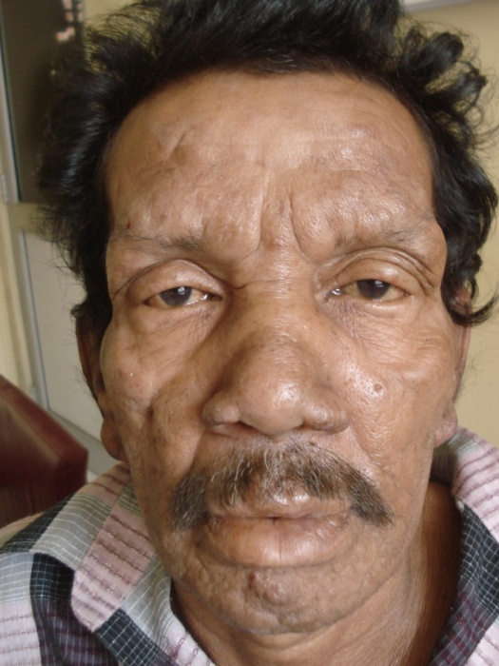
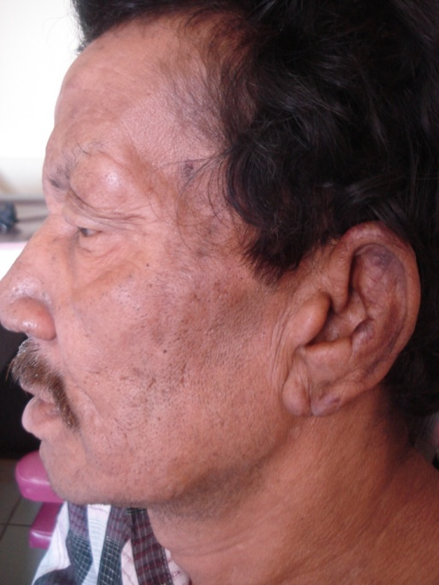
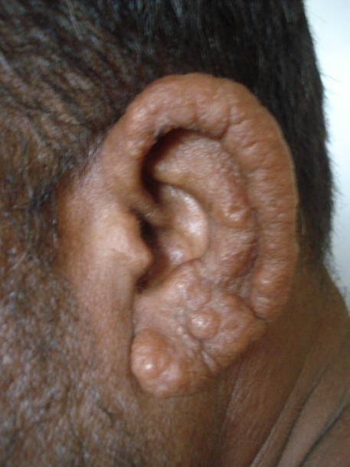
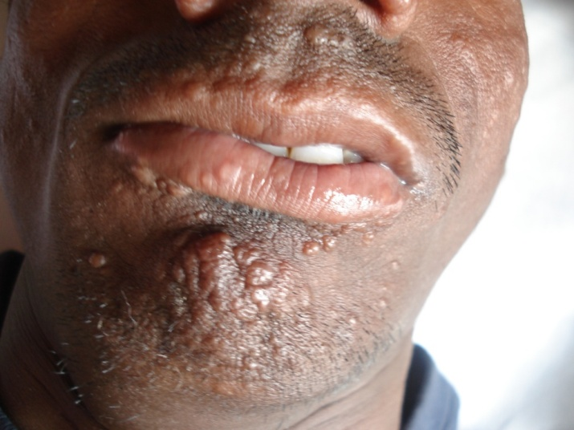
Facial change
Leonine facies
Diffuse thickening of facial skin
Earlobe nodules
Collapse of nasal bridge
Thickening of eye-brows
Loss of hair in eye-brow (madarosis)
Papules/ nodules in the chin

Slide 18
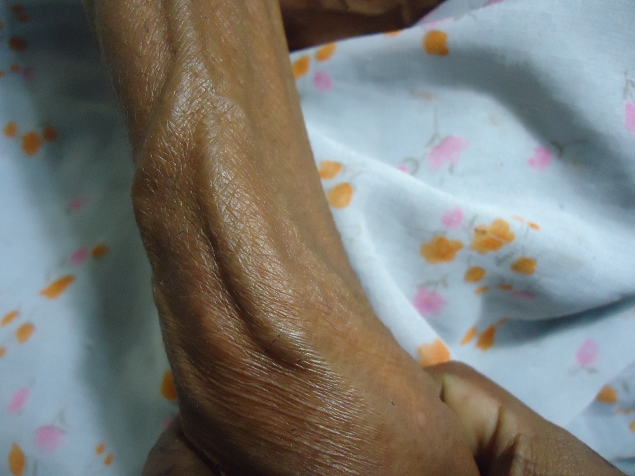
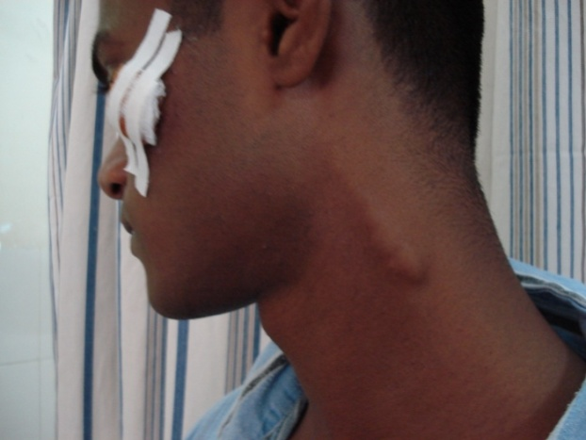
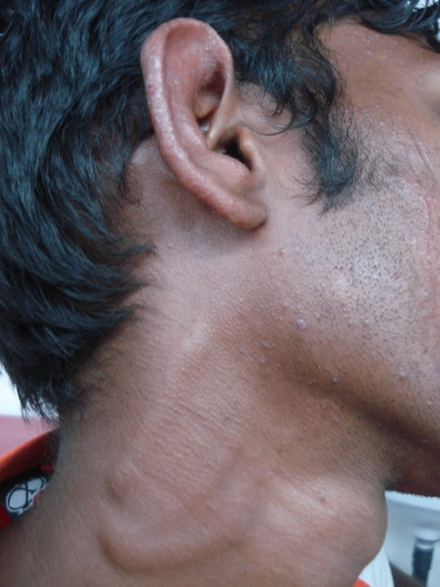

Thickened peripheral nerves
Commonly palpated nerves:
Greater auricular
Ulnar
Radial cutaneous
Median
Common peroneal
Posterior tibial
sural

Slide 19
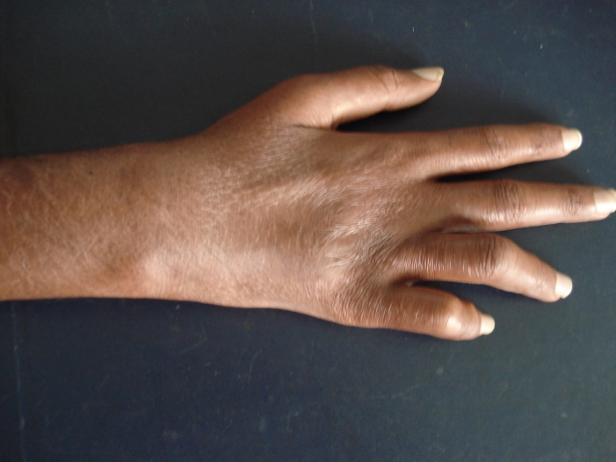
Nerve palsy
Commonest are ulnar claw and foot drop
Resembles mononeuritis multiplex of diabetes
A thickened, tender nerve is supportive of leprosy

Slide 20
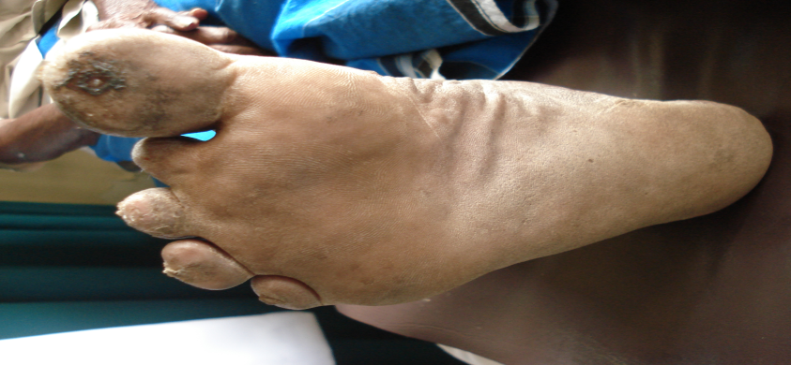
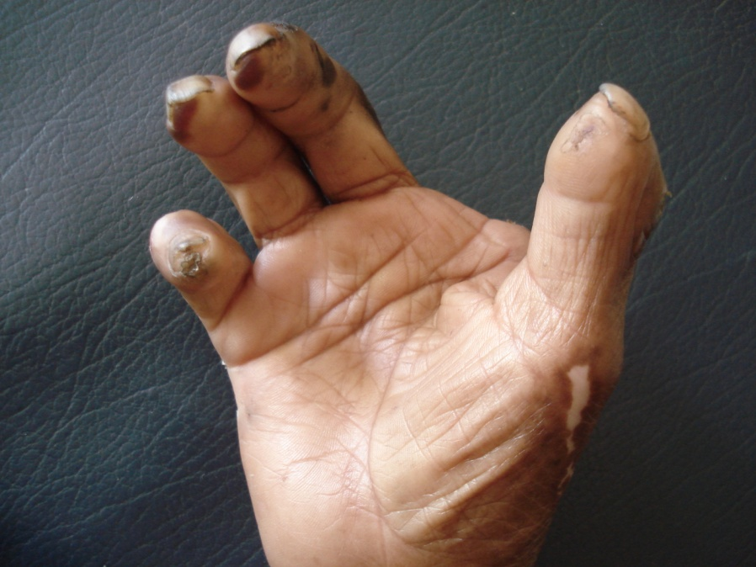
Non healing ulcer
Occur due to numbness of soles & palms due to neuropathy
Similar to diabetic ulcers
May lead to auto/ surgical amputation
Consider leprosy in a relatively young, normoglycaemic person with non healing ulcers

Slide 21
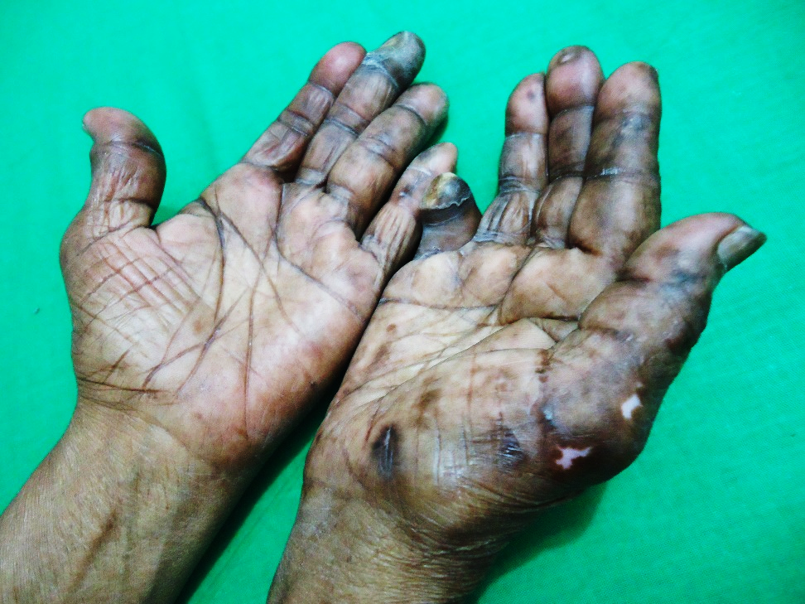
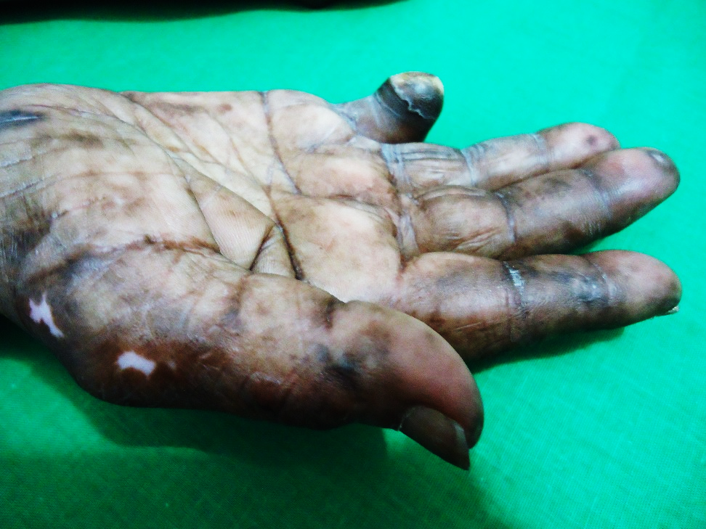
Non healing ulcer

Slide 22
Type 1 reaction clinical features
Inflammation (pain, swelling, redness) of existing lesions
Appearance of a few new lesions
Oedema of extremities
New sensory loss
New weakness of muscles
Nerve pain
Nerve tenderness, oedema around the nerves or abscess formation
If there is inflammation in a lesion near the eye there may be eye involvement that could threaten the vision. Such patients may need urgent eye referral.

Slide 23
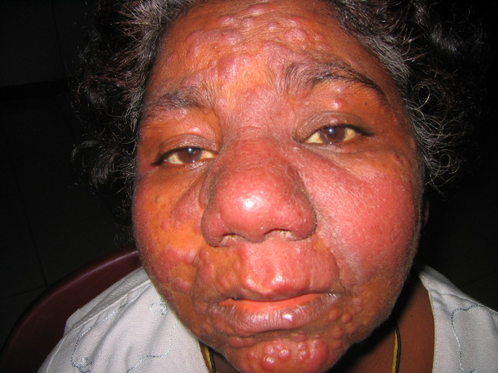
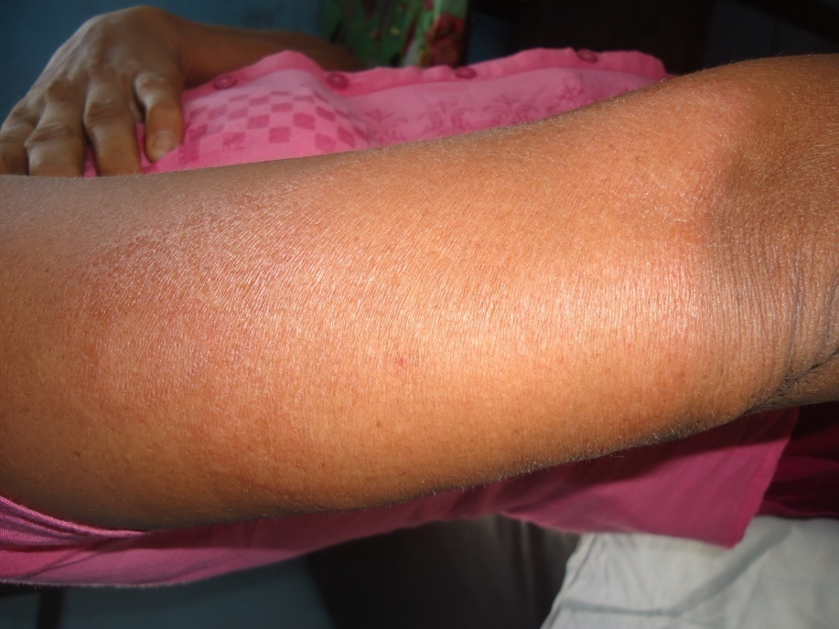
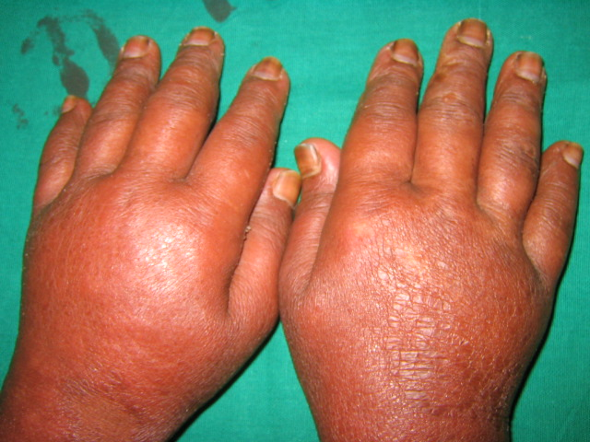

Slide 24
ENL reaction clinical features
Painful, tender erythematous nodules in the trunk and limbs
Fever
Malaise
Oedema of the extremities
Eye involvement (iritis, conjunctivitis)
Joint pain, swelling or stiffness
Bone pain and tenderness (sp. Tibial tenderness)
Lymphadenopathy
Hepato-splenomagaly
Orchitis
Nerve damage (may not be as severe as T1R)
Proteinuria

Slide 25
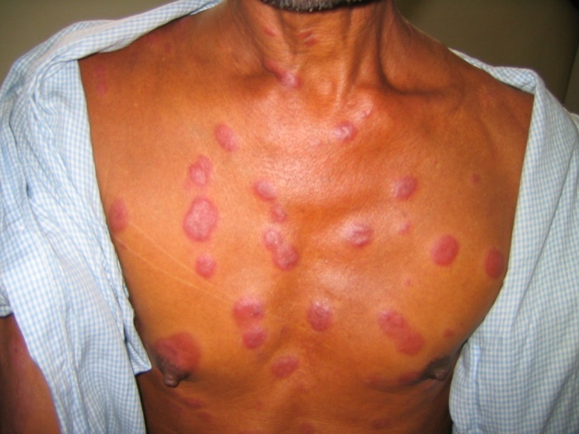
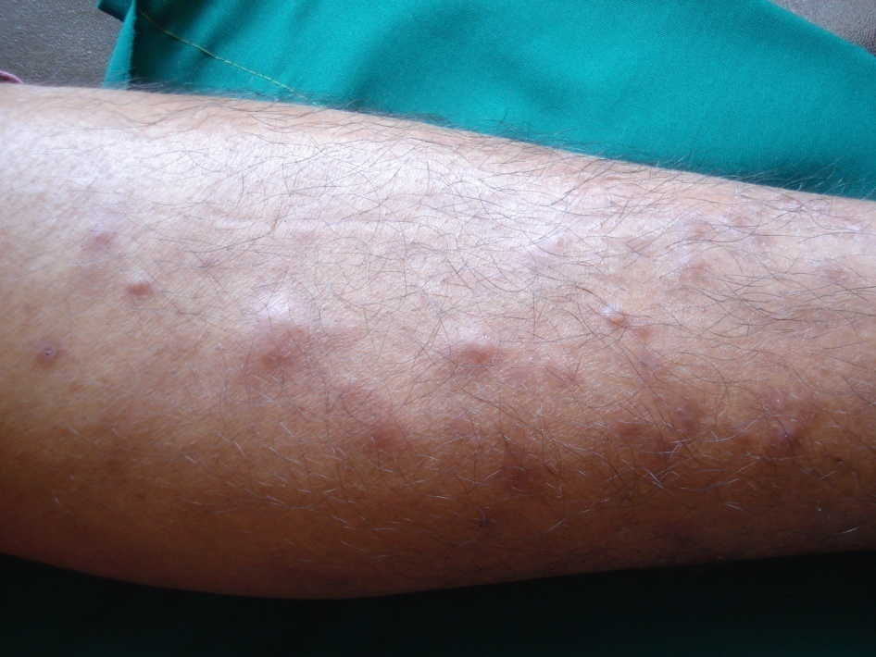
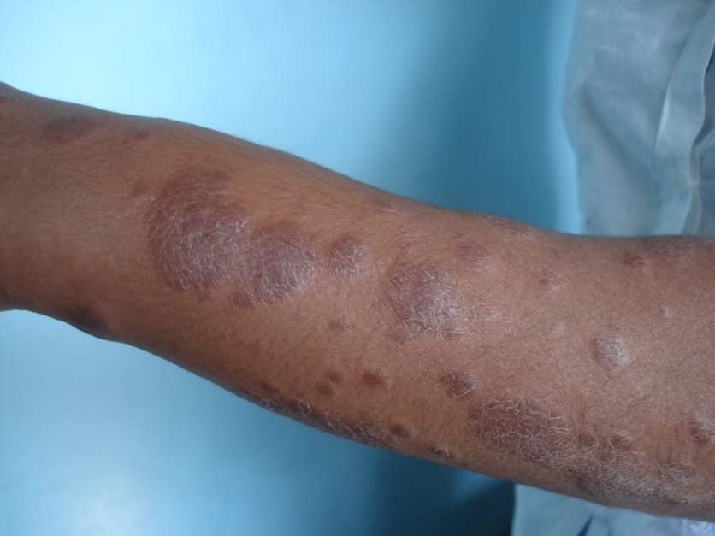
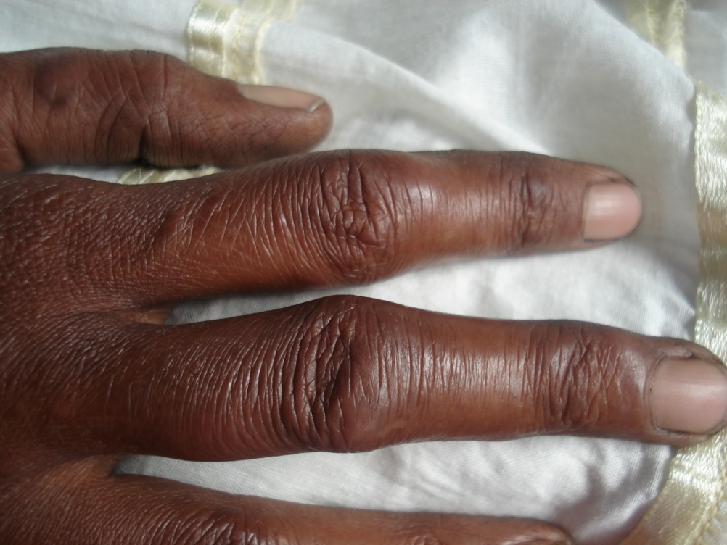

Slide 26
Uncommon presentations

Slide 27
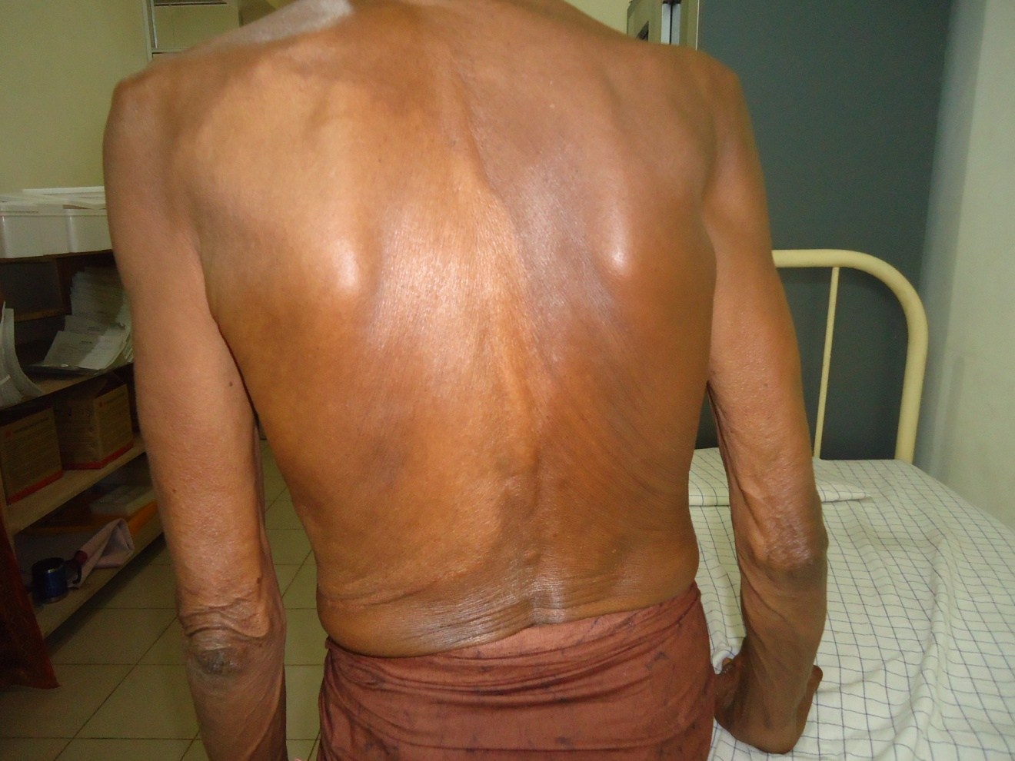
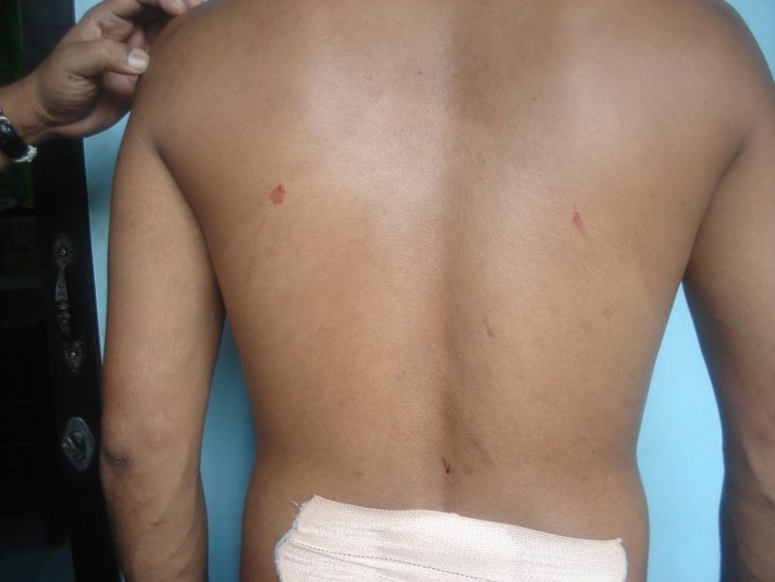
Large hypo-pigmented patches

Slide 28
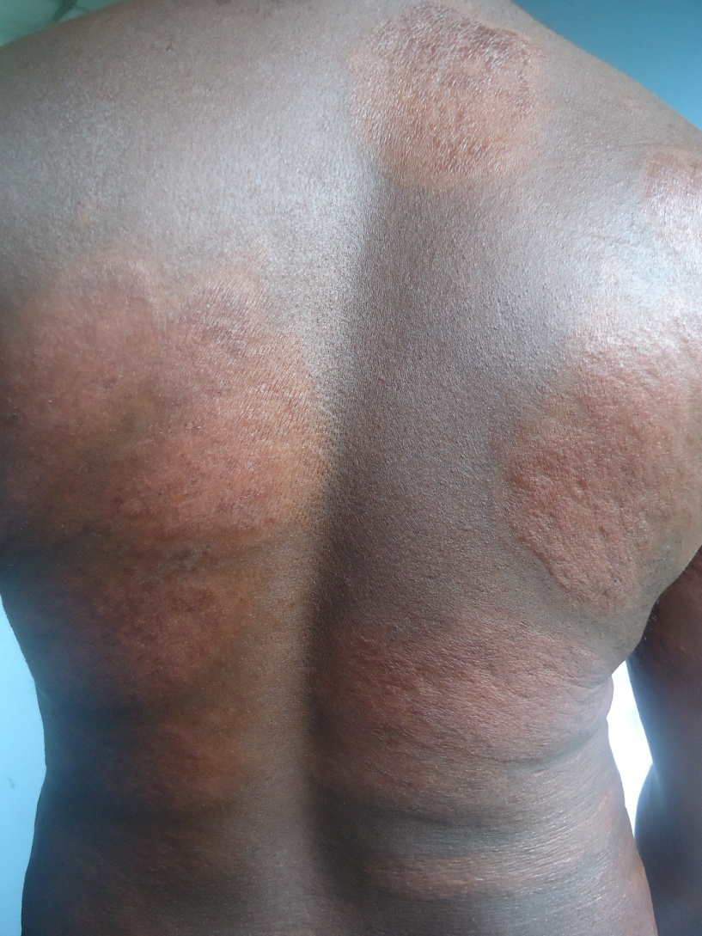
Large copper coloured plaques

Slide 29
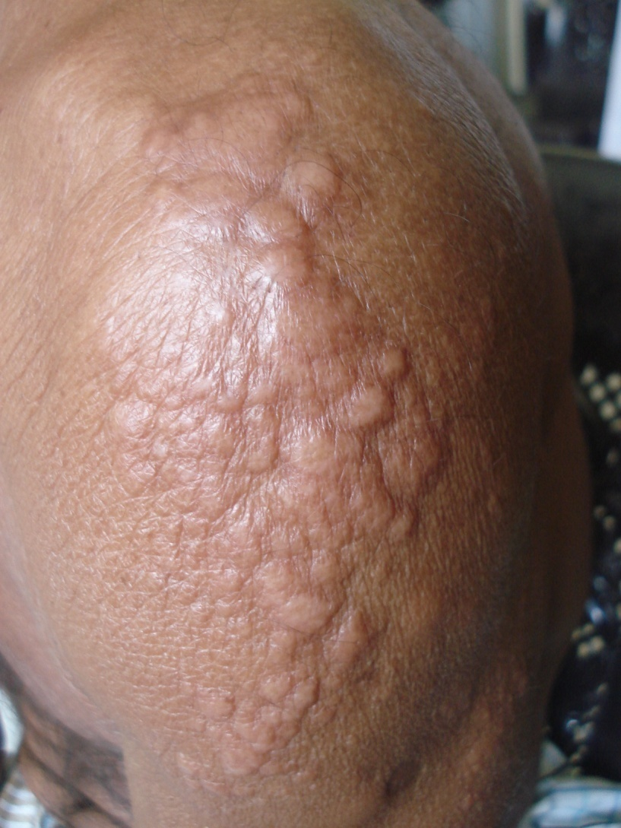
Histoid leprosy
Present as small papules
May be localized or generalized
Large number of bacilli
May be associated with peripheral neuropathy
May need treatment for longer periods

Slide 30
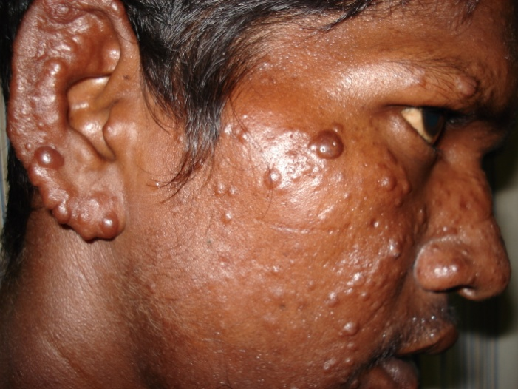
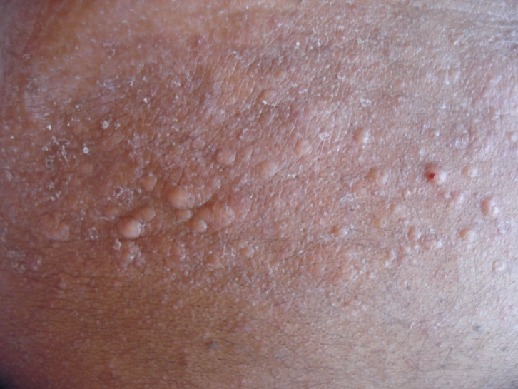
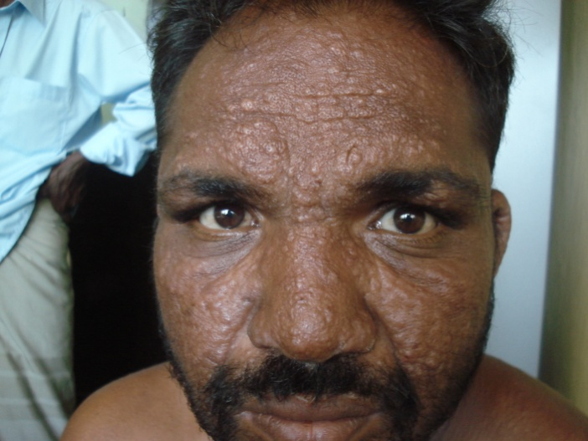
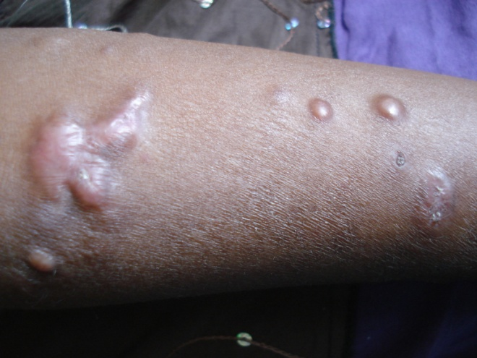

Slide 31
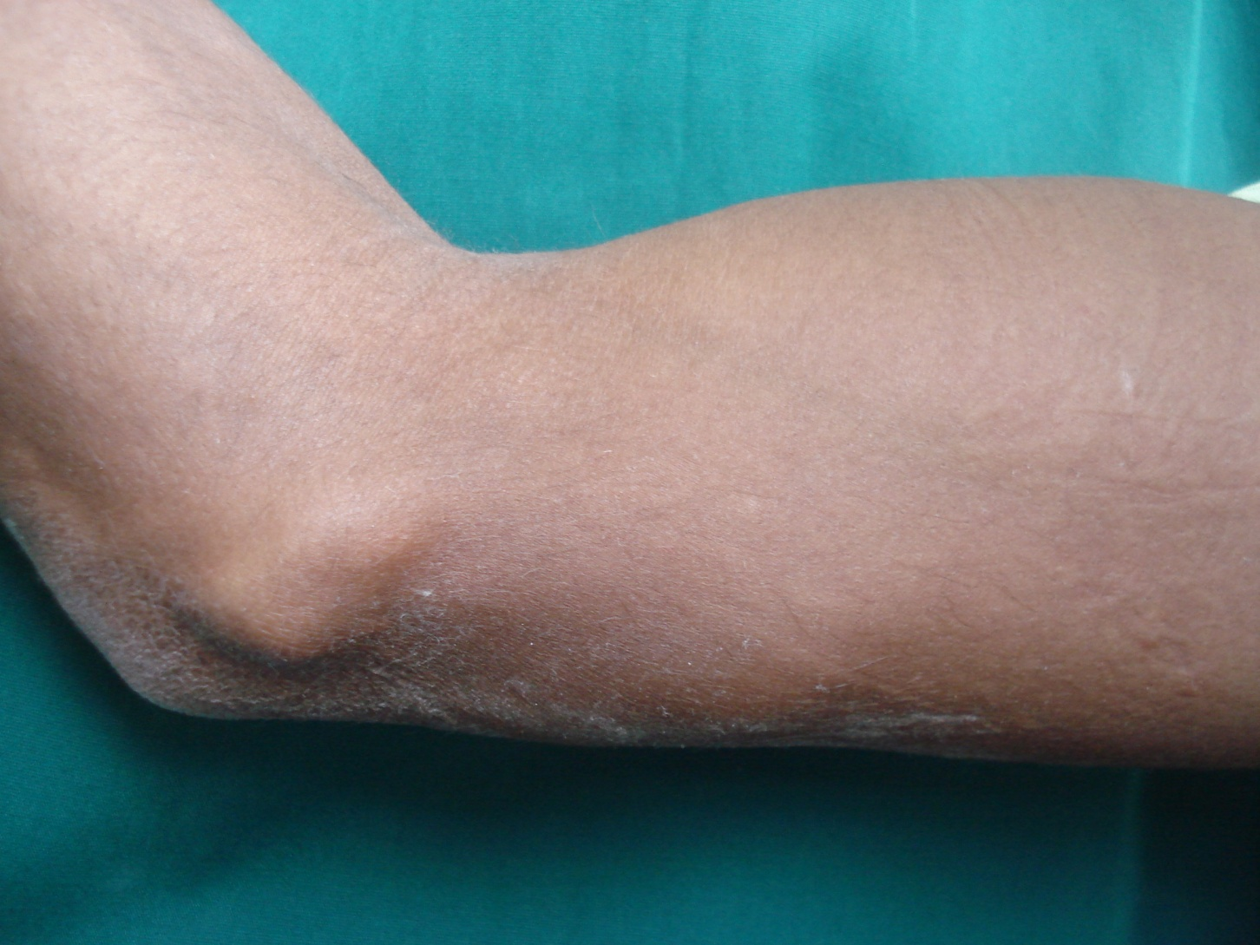
Nerve abscess

Slide 32
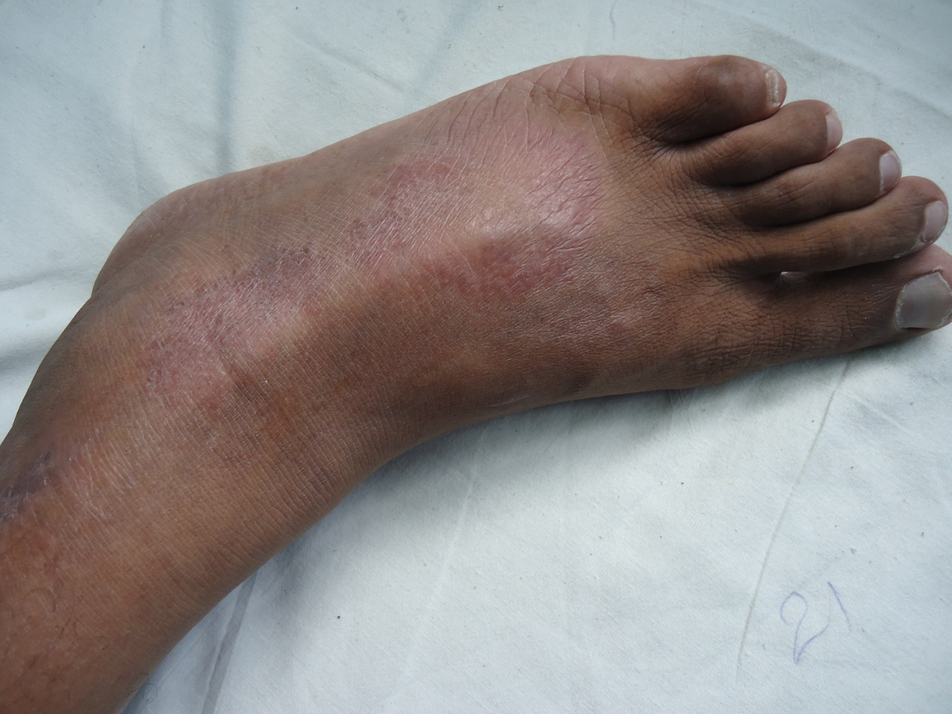
Dry ichthyotic patch with thickened nerve

Slide 33
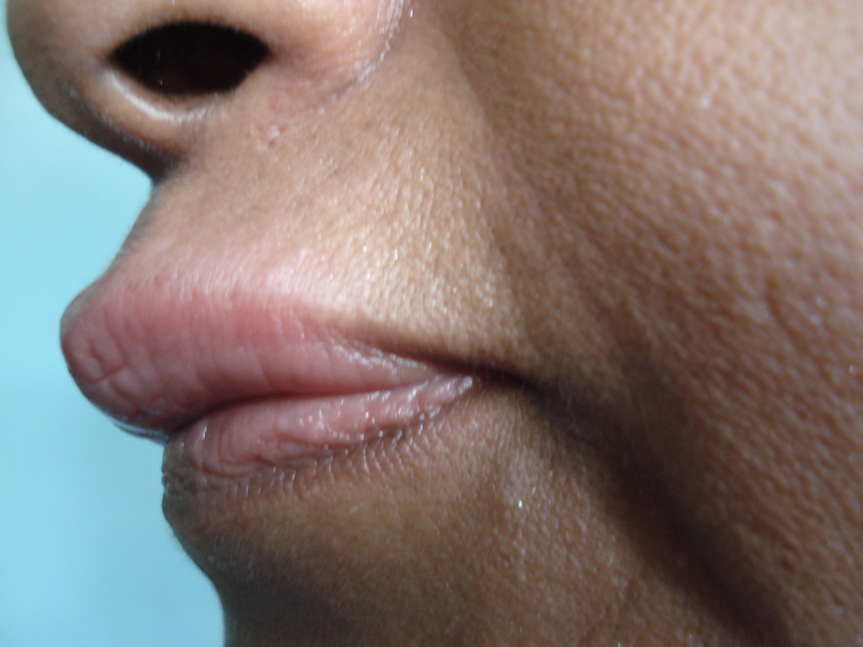
Mucosal change

Slide 34
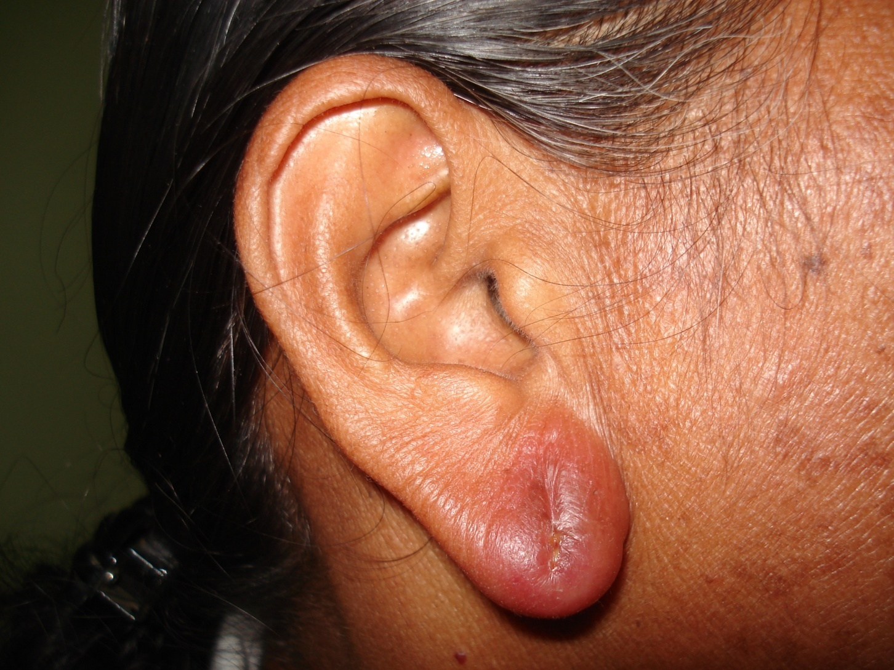
Diffuse erythematous swelling of earlobe

Slide 35
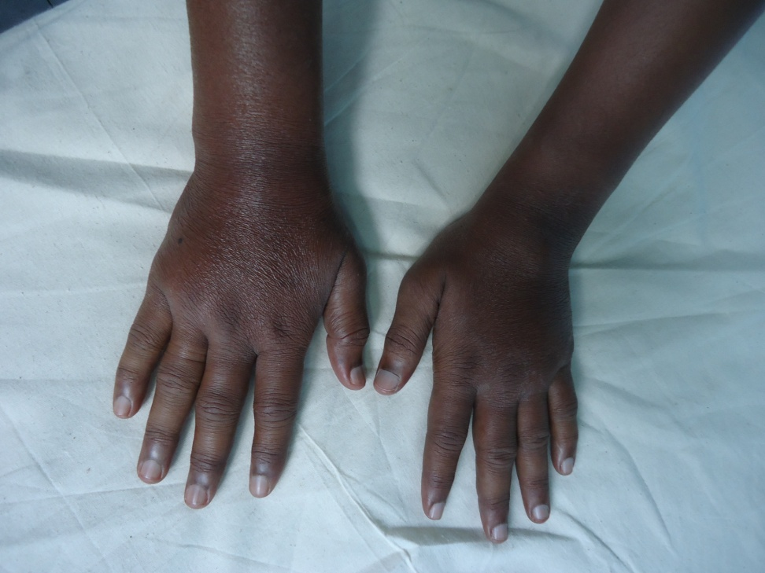
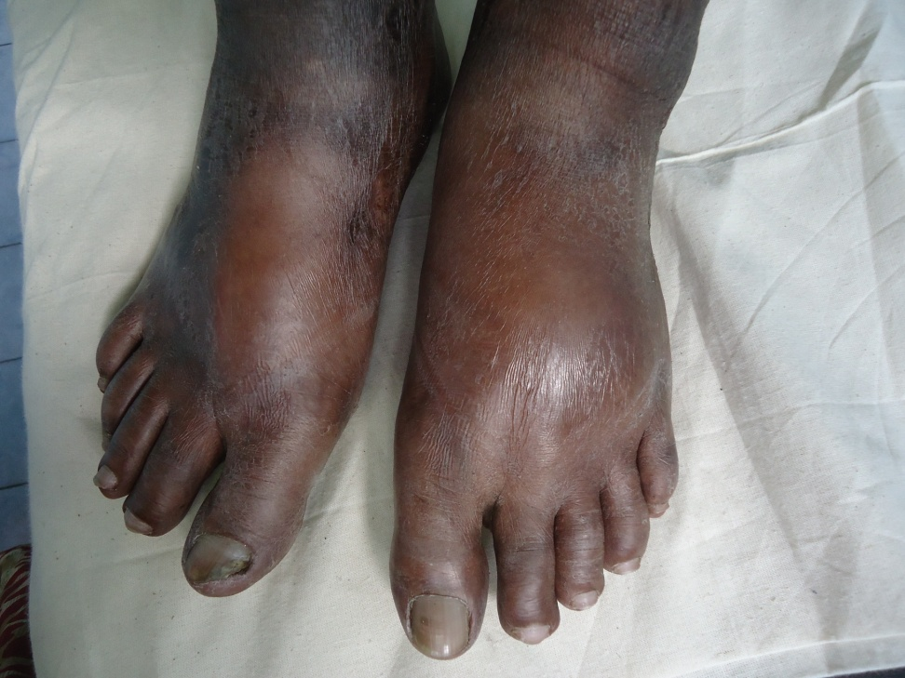
Type 1 reactions may resemble generalised oedema

Slide 36
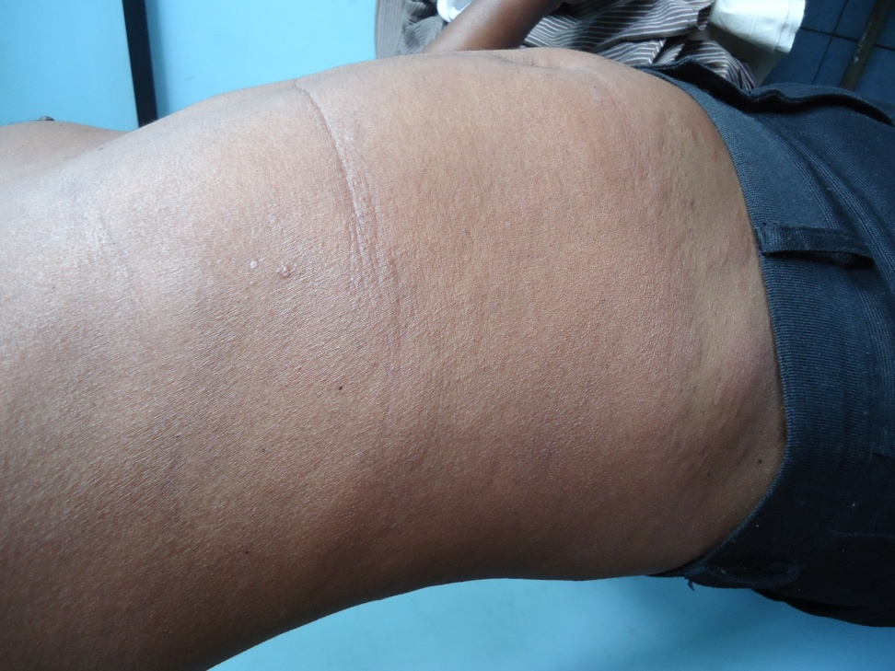
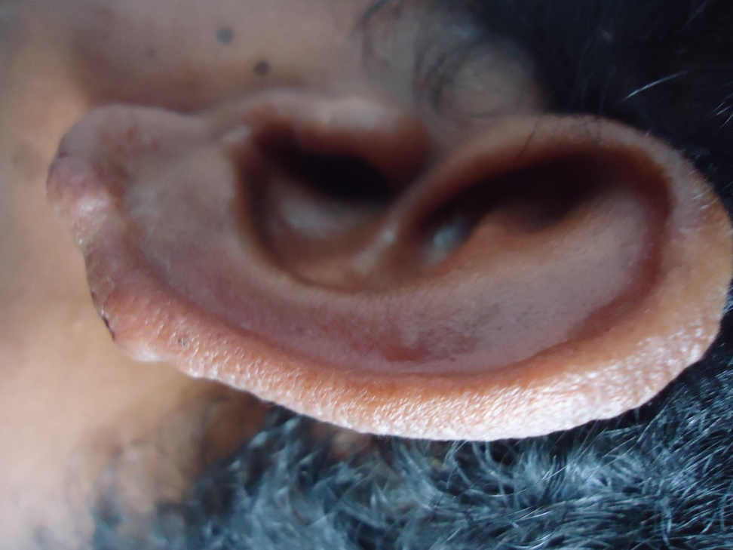
Type 1 reactions may resemble generalised oedema
BI = +5
BI = +6

Slide 37
Diagnosis of leprosy

Slide 38
How is leprosy diagnosed?
Mainly a clinical diagnosis
Other useful investigations
Slit skin smear may be of use in multibacillary cases and also in follow up
Skin biopsy in doubtful cases
Nerve conduction studies
High resolution ultrasonography of affected nerves
Nerve biopsy of the affected nerve
Serology and PCR are not routinely used for diagnosis

Slide 39
Treatment of leprosy

Slide 40
To decide on the type of treatment You can be guided by the following:
 | Paucibacillary (PB) | Multibacillary (MB)
Total number of skin patches | 1-5 | 6 or more
Number of thickened nerves | 1 | 2 or more
Slit skin smear (if available) | negative | positive

Slide 41

Paucibacillary (PB) leprosy
Less than 5 skin lesions
Treated with 2 drugs
Monthly rifampicin
Daily dapsone
Treatment duration 6 packs (24 weeks)
Green pack for adults >15 years
Blue pack for children 10 -14 years
Children <10y adjust dose for weight

Slide 42

Multibacillary (MB) leprosy
6 or more patches
3 drugs
Monthly rifampicin
Daily dapsone
Monthly and daily clofazimine
12 packs (48 weeks)
Red pack for adults
Brown pack for children(10 -14)

Slide 43


Treatment related problems
Common adverse effects
Orange red urine with rifampicin
Feeling unwell/ lethargy due to mild haemolysis and methaemoglobinaemia
Pigmentation and dry skin with clofazimine

Slide 44
Uncommon adverse effects
Dapsone induced haemolysis (11%)
Dapsone intolerance (8%)
Hepatitis (4%)
Dapsone syndrome (1.6%)
Stevens Johnson syndrome
Flu like syndrome due to rifampicin
Dapsone syndrome
Idiosyncratic reaction
4-6 weeks after start of MDT
Fever, sore throat, photosensitive rash, organomegaly
Hepatic impairment may lead to hepato-renal syndrome and even death

Slide 45

Rash in dapsone syndrome

Slide 46
Second line drugs
Ofloxacin
Minocycline
Clarithromycin
Moxifloxacin

Slide 47
Leprosy reactions and the eye
The eye can be affected in both T1R and ENL
T1R
Weak eye closure due to facial nerve weakness leads to exposure keratitis
Patients with skin lesions in close proximity to the eye are at higher risk of eye involvement
Always remember to examine for eye closure in patients with T1R
ENL
Can manifest as iritis, episcleritis or conjunctivitis
Clinically present as painful red eyes, small irregular pupils and photophobia
Can lead to blindness if left untreated

Slide 48
Public health aspects
Leprosy is a notifiable disease (mainly for defaulter tracing and contact examination)
Isolation of cases is not recommended
Most cases are detected by passive case detection
There is a special system of notification (Individual Patient Form- IPF) to generate all national data
Patients are given a card which gives a summary of the illness
Contact examination plays a very important role in detecting new cases

Slide 49
Contact examination
LRH Colombo 2011: 33% of the index cases had a positive contact within the household. 11% had more than one member affected.
GH Polonnaruwa 2008/09: 20% of index cases had at least one positive contact in the household
BH Homagama 2016: out of 63 contacts for 21 index cases examined 12 were positive for 6 index cases. 28.9% of index cases had a positive contact. In almost all child cases there was a contact at home.

Slide 50
Is drug resistance a problem?
Specific gene mutations conferring resistance to rifampicin, dapsone and ofloxacin have been identified
WHO sentinel surveillance on drug resistance is underway
increase in mono resistance
rifampicin resistance commoner than dapsone resistance
out of 1607 cases that became positive there were 69 cases (4.3%) of rifampicin resistance and 64 cases (4%) of dapsone resistance
(Source: Dr. E. Cambau, WHO expert on drug resistance)
Plans to include Sri Lanka in the WHO sentinel surveillance are underway.

Slide 51
Management of disability
Best management strategy is prevention of disability
Be vigilant for nerve function impairment
Treat nerve function impairment/ type 1 reaction early
Physiotherapy/ occupational therapy play a major role

Slide 52
Care of the anaesthetic limb
Regular inspection of the hands/ feet
Callus formation
Cracks
Wounds
Soaking of the feet in water
20 min/ day
NOT HOT WATER.
May use tap water with a pinch of salt added
In a basin large enough to keep both feet comfortably

Slide 53
Care of the anaesthetic limb
Paring/ cutting off callus
Healthcare worker may pare off callus using a large scalpel blade
Always keep the blade parallel to the surface of the skin
Peel off thin slices of skin
Continue until you feel that the thickness of the skin has reduced
Patient may use a rough piece of stone/ pumice stone at home to rub the thick areas
DO NOT encourage use of blades at home

Slide 54
Care of the anesthetic limbs
Oiling/ moisturizing
After soaking and paring, dry the limb
Use any greasy substance available at home
Aqueous cream/emulsifying ointment can be provided from the clinic
Dressing of any wounds
Depending on the severity of the wound
Wound care kits are provided for the patient

Slide 55
Care of the anaesthetic limbs
Advise on
Cutting of nails
Treatment of maceration of web spaces
Proper footwear to be used
No slippers, need sandals with a strap behind
No pointed shoes, square toed is best
Flat shoes vs. high heeled shoes
Shoes should cover the foot as much as possible
Use of appliances when handling hot objects

Slide 56
Some simple appliances that can be used
Protection of eyes
Glasses
Headclothes
Pads to cover eyes while sleeping
Long pipe to blow into the fire
Protection of hands
Adaptation of tools
Gloves
Pot holders/ cooking gloves
Padding around handles
Long handles to hold hot things
Cup holders

Slide 57
Simple tools for protection of feet
Protective footwear
MCR shoes are provided from the clinic
Foot drop springs
Drop foot support
Crutches
Walking sticks
Cloth wrapped around feet while sitting on ground

Slide 58

Thank you

